Slide 1
MANAGER''S
GUIIDE
ANNUAL PERFORMANCE EVALUATIONS
UTILIZING ONEUSG EPERFORMANCE MODULE

Slide 2
Enter goals (Define Criteria)

Slide 3
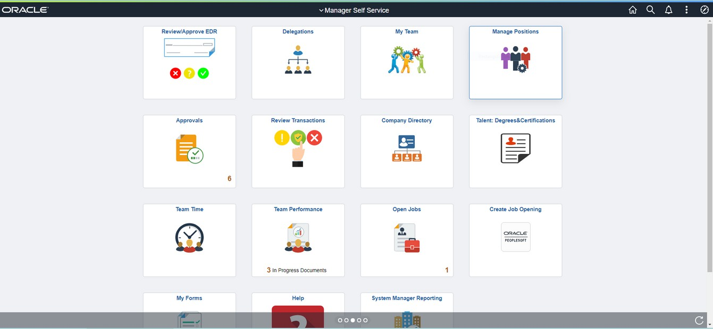
MANAGER: NAVIGATING TO EVALUATIONS
1
2
Log into OneUSG Connect.
Select Manager Self Service (if you are completing an evaluation of someone else).
Select Team Performance.

Slide 4
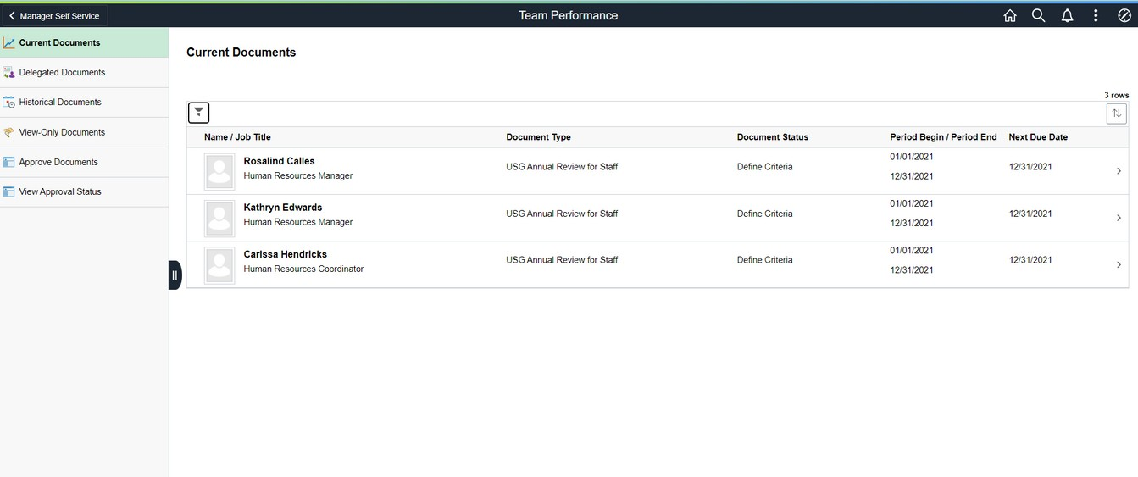
MANAGER: NAVIGATING TO EVALUATIONS
This screen shows the manager each person assigned to them for evaluation. This is based on the "Reports To" structure in OneUSG Connect. If someone is on your list that should be removed or if someone is missing, please send an email to hr@sgsc.edu with the subject "EPerformance Manager Update".
Document Status will tell you at what step of the process the evaluation is currently. As you complete evaluations, the individual name disappears from this main screen and moves to "Historical Documents".
Click on a name to begin the process.

Slide 5
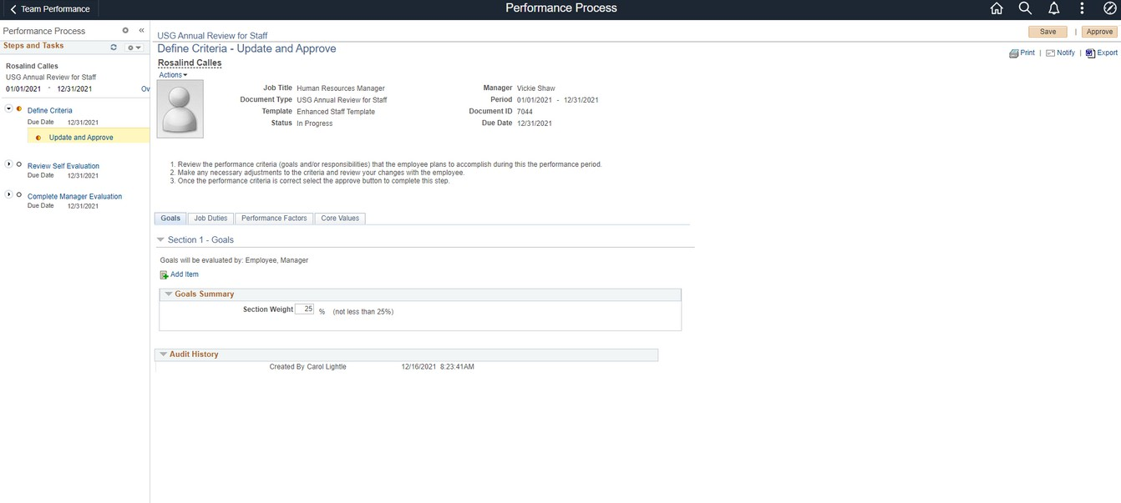
MANAGER: DEFINE CRITERIA/GOALS
3
3. On the Goals tab, you will need to add the goals set on LAST YEAR'S evaluation. Click "Add item" for each goal set for the year you are evaluating.
While it appears that you can edit the Section Weight, the system will not allow you to alter this.

Slide 6
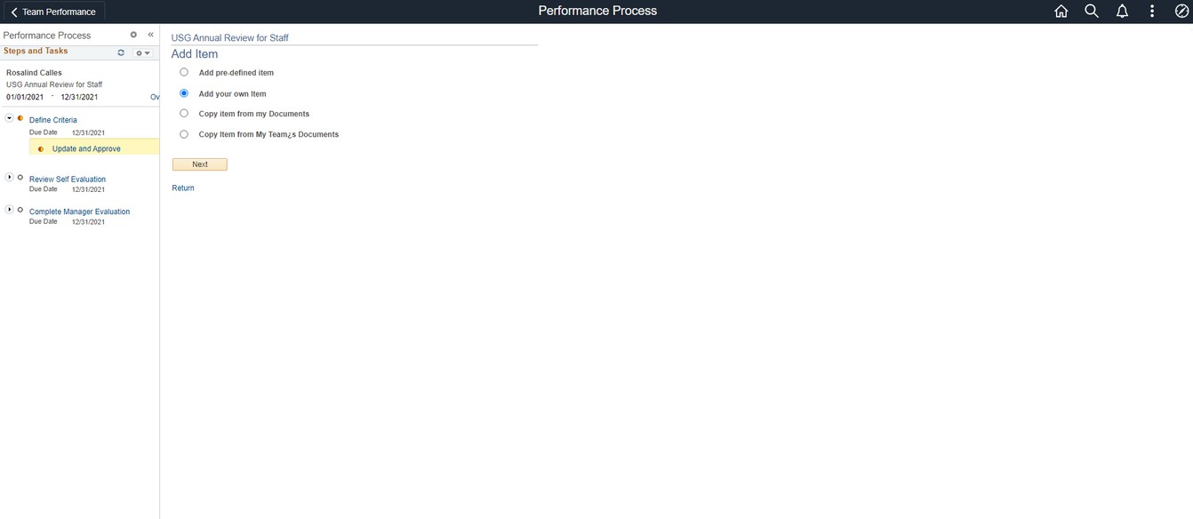
MANAGER: DEFINE CRITERIA/GOALS
4
4. Select "Add your own item" to enter the description of each goal.

Slide 7
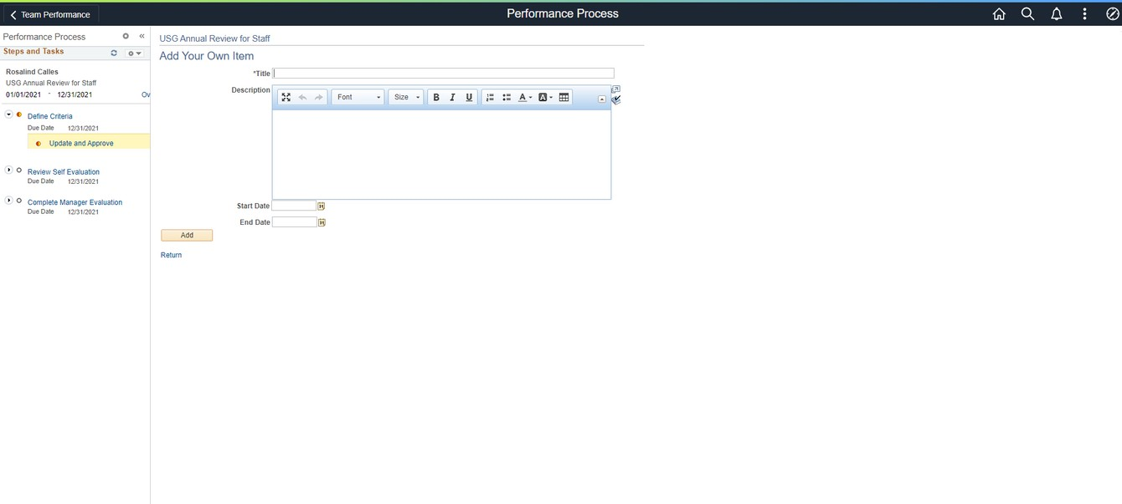
MANAGER: DEFINE CRITERIA/GOALS
5
6
Enter a title (brief description) under title and a full description in the larger box. You can use the formatting functions as you would in a Word document (lists, bold, italics, etc). If there were specific dates associated with the goal, you can enter those as well.
Click Add.
Repeat these steps until you have entered all goals.

Slide 8
MANAGER: DEFINE CRITERIA/GOALS
7
8
Click SAVE often! If you have made edits and leave the system (or it logs you out automatically due to inactivity), you will lose anything you have not saved.
Once you have entered all the goals, click Approve. This sends the evaluation to the employee so they can complete their Self Evaluation.

Slide 9
Enter goals (Define Criteria)

Slide 10
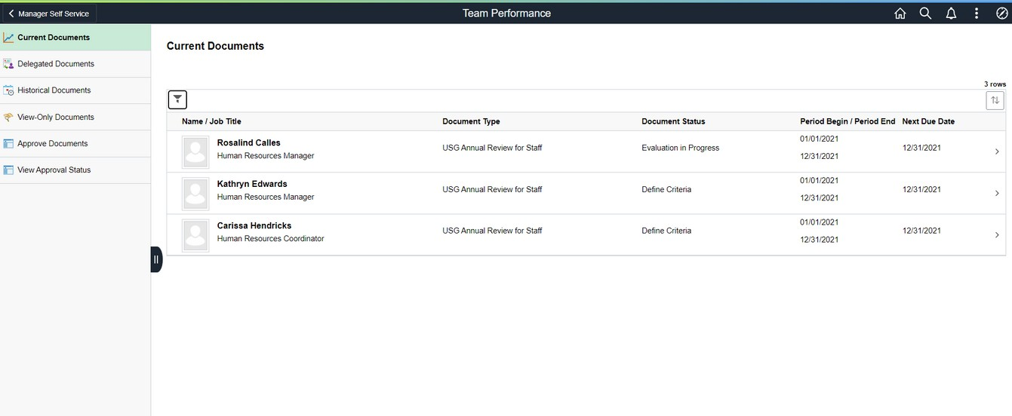
MANAGER: REVIEW SELF EVALUATION
Once the employee finishes their Self Evaluation, log into OneUSG Connect and navigate to Manager Self Service and Team Performance.
As you see here, "Evaluation in Progress" indicates the evaluation was started. "Define Criteria" are the ones you have not yet started.

Slide 11
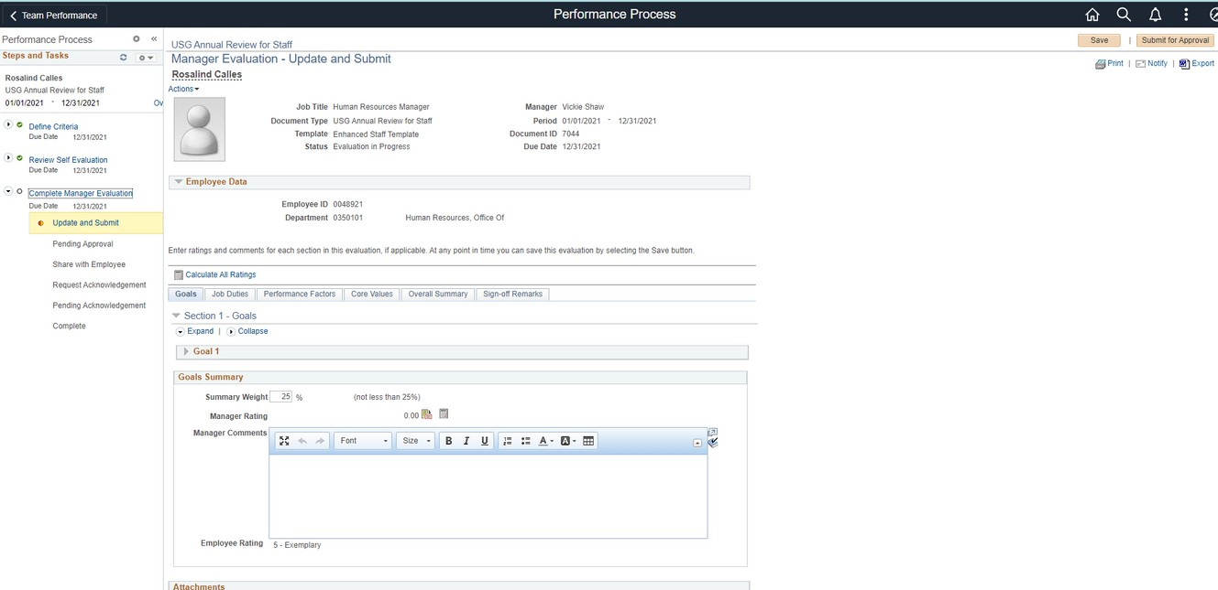
MANAGER: REVIEW SELF EVALUATION
9
10
Click on Review Self Evaluation to view the full self evaluation submitted by the employee. You can navigate to each tab to review comments and ratings provided by the employee. You will also be able to view the ratings and comments by the employee as you navigate through the Manager Evaluation.
Click on Complete Manager Evaluation to begin your evaluation of the employee.

Slide 12
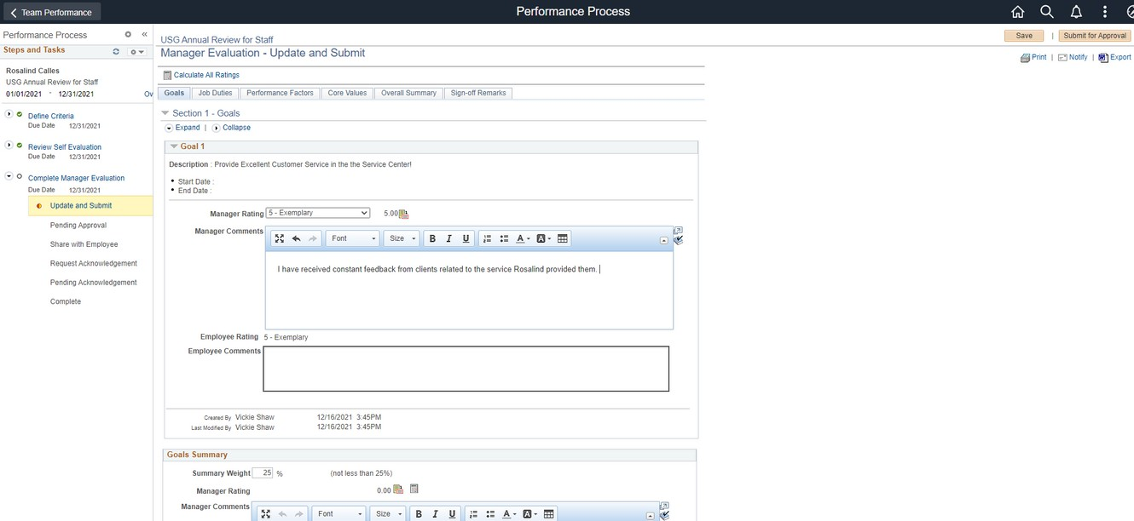
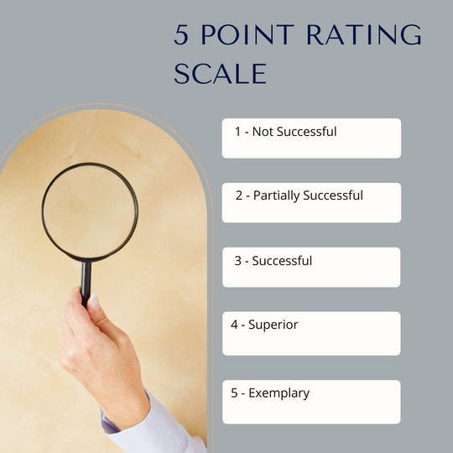
MANAGER: EVALUATE GOALS
13
11
12
1 - Not Successful
2 - Partially Successful
3 - Successful
- Superior
- Exemplary
You will provide a rating on each goal using the 5 point rating scale.
For ease of use on any tab, click Expand to provide a full view of each item on that tab.
Select the rating for each goal listed. For any rating other than "3 - Successful" you should add comments to explain why you selected this rating. You can use the formatting functions as you would in a Word document (lists, bold, italics, etc).
Click SAVE often! If you have made edits and leave the system (or it logs you out automatically due to inactivity), you will lose anything you have not saved.

Slide 13
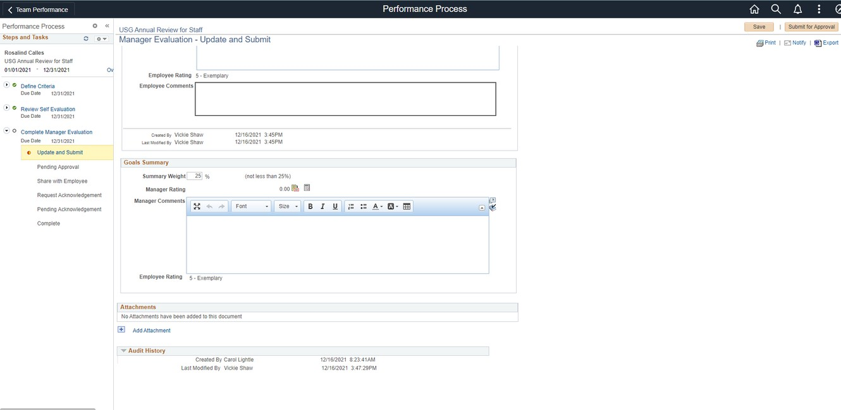
MANAGER: EVALUATE GOALS
16
14
15
The system will automatically calculate the overall Goals rating.
Add any overall comments you have related to goals.
You can attach documents to support anything in the evaluation (certificates, list of training completed, etc). However, there is no requirement to upload attachments.
Click SAVE often! If you have made edits and leave the system (or it logs you out automatically due to inactivity), you will lose anything you have not saved.
While it appears that you can edit the Section Weight, the system will not allow you to alter this.

Slide 14
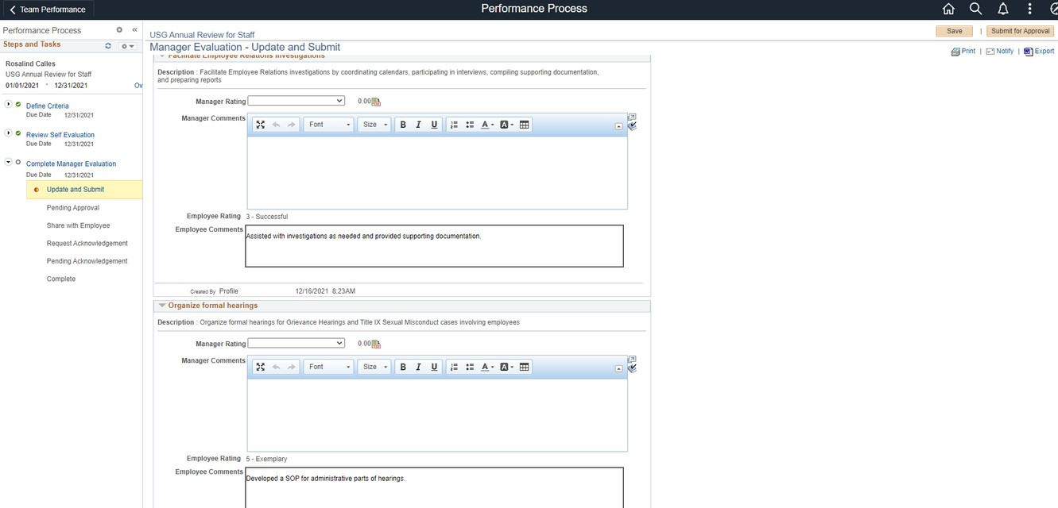
MANAGER: EVALUATE JOB DUTIES
18
17
1 - Not Successful
2 - Partially Successful
3 - Successful
- Superior
- Exemplary
You will provide a rating on each job duty using the 5 point rating scale.
Select the rating for each job duty listed. For any rating other than "3 - Successful" you should add comments to explain why you selected this rating. You can use the formatting functions as you would in a Word document (lists, bold, italics, etc).
Click SAVE often! If you have made edits and leave the system (or it logs you out automatically due to inactivity), you will lose anything you have not saved.

Slide 15
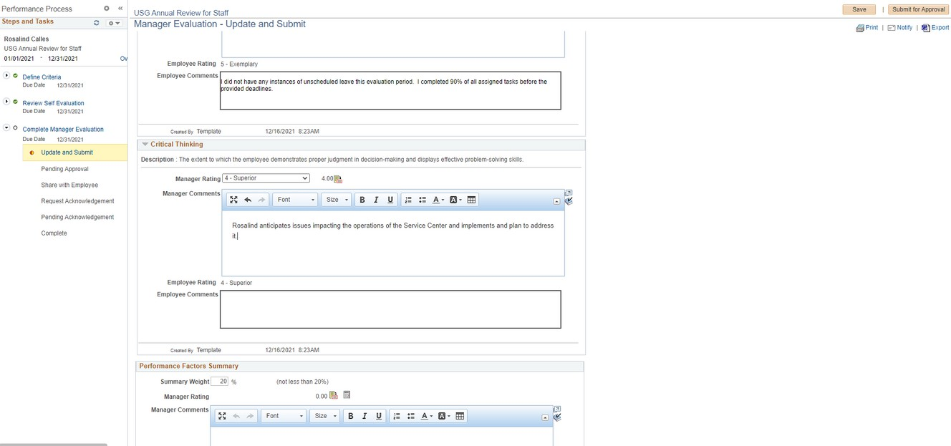
MANAGER: EVALUATE PERFORMANCE FACTORS
20
19
1 - Not Successful
2 - Emerging
3 - Successful
- Superior
- Exemplary
Performance Factors are defined at the University System of Georgia level for all employees.
Provide a rating to each Performance Factor. If the rating is higher or lower than "3-Successful", you should provide comments to support the rating.
Click SAVE often!
While it appears that you can edit the Section Weight, the system will not allow you to alter this.

Slide 16
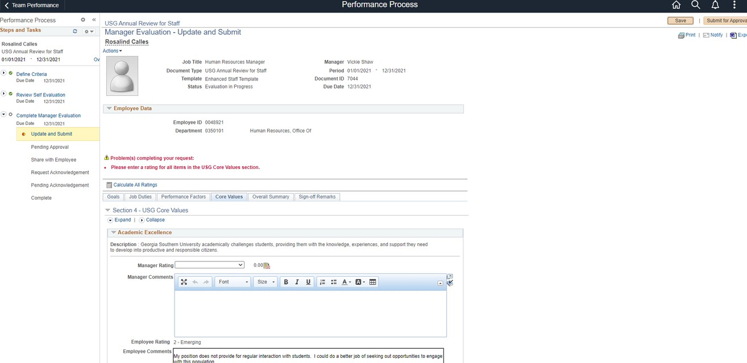
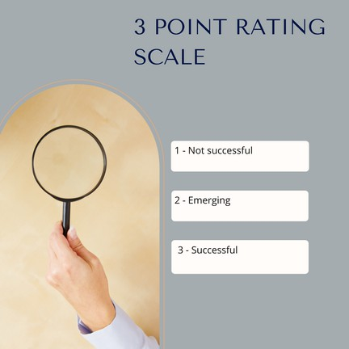
MANAGER: EVALUATE VALUES
22
1 - Not Successful
2 - Emerging
3 - Successful
21
All employees will be evaluated on their support of the USG Core Values. Values are rated on a 3-point scale.
Provide a rating for each Core Value. You can attach documents to support anything in the evaluation (certificates, list of training completed, etc). However, there is no requirement to upload attachments.
Click SAVE often!
NOTE: If you fail to complete a rating for any item on any tab, you will get the error message that appears in red.

Slide 17
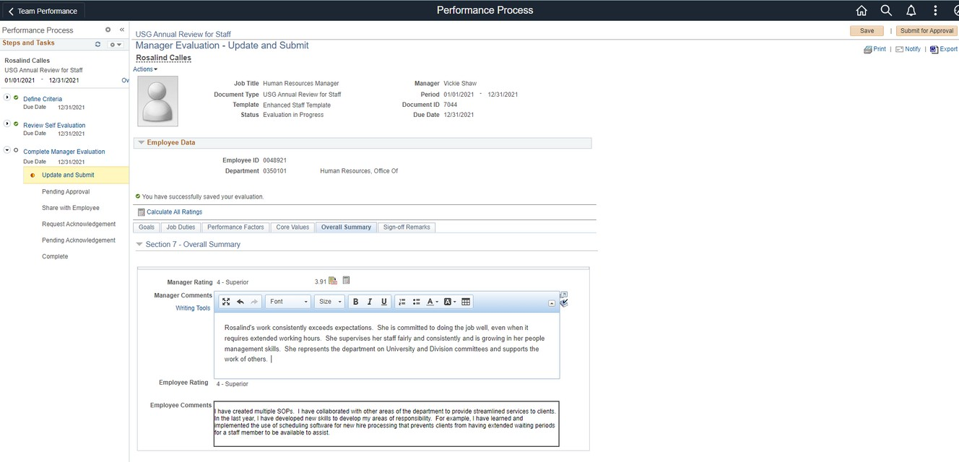
MANAGER: OVERALL RATING
24
23
The system will automatically calculate the overall rating for the evaluation. On this tab, you will add any overall comments you have. Consider adding any particular successes/accomplishments or challenges the employee faced this past year.
Click SAVE one last time and then click SUBMIT FOR APPROVAL.

Slide 18
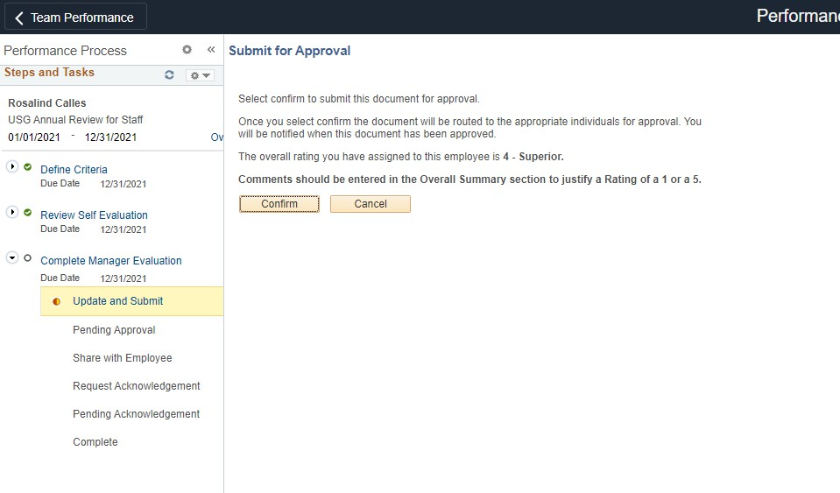
MANAGER: SUBMIT FOR APPROVAL
To submit the evaluation for approval (from next level supervisor), click CONFIRM. If you'd like to go back and make changes, click CANCEL to make the changes and follow the steps to get back to this screen.
The evaluation will be available for your manager (2-up from person being evaluated) to review once you click complete and you cannot make any further changes.

Slide 19
MANAGER: CONFIRMATION - APPROVAL SUBMITTED
From this screen, you can navigate back to the other evaluations assigned to you by clicking the "Team Performance" arrow in the upper left corner.

Slide 20
MANAGER: NOTIFICATION OF DENIAL
If an evaluation is denied, you will receive notification. Click on the notification icon (bell) to see the notification. Clicking on the notification will take you to the denied evaluation.
Notice the red notification indicating the evaluation has been denied. You cannot send the evaluation to the employee until revisions have been made and approved. Make these revisions following the above directions on navigating through the evaluation and submitting it for approval.

Slide 21
Enter goals (Define Criteria)

Slide 22
MANAGER: SHARE WITH EMPLOYEE
25
26
Click on the evaluation you want to share. NOTE: The Document Status indicates "Approval - approved".
Click Share with Employee. This sends a notification to the employee to review the evaluation you have completed. You can also click the "Export" button to export a Word document of the evaluation to use during the face to face meeting with the employee.

Slide 23
MANAGER: CONFIRM SHARE WITH EMPLOYEE
27
27. Confirm that you want to share the evaluation with the employee.

Slide 24
EMPLOYEE/MANAGER: EVALUATION MEETING
The performance evaluation meeting is an opportunity to have an honest conversation between the employee and the manager. The employee should be given an opportunity to share their thoughts on their performance, any challenges they've faced, what they think they accomplished in the last year and ways the manager has either supported or hindered their progress. The manager should have the opportunity to reinforce feedback given throughout the year, highlight accomplishments o the employee and discuss what they observe as opportunities for growth and development. After a review of the performance evaluation document, the manager and employee should set goals for the coming year. It is completely acceptable to ask the employee to come to the evaluation with several goals in mind for the coming year.
SETTING GOALS
You will need to set and document goals for the coming year with each employee. Here are some tips to consider:
*Set goals that align with the strategic plan, our strategic pillars and the values of the University.
*Ask the employee about any job specific goals that are meaningful to them.
*Set SMART goals (specific, measurable, achievable, relevant and time-based)
*Don't be overly ambitious or unrealistic.
*Set consistent goals for employees with similar responsibilities within your department.
*Goals may be centered around one of the following: Job description, project goals, behavioral goals, stretch goals
Note:
You will not be able to enter the new goals in the system at the time of this year's evaluation.

Slide 25
Enter goals (Define Criteria)

Slide 26
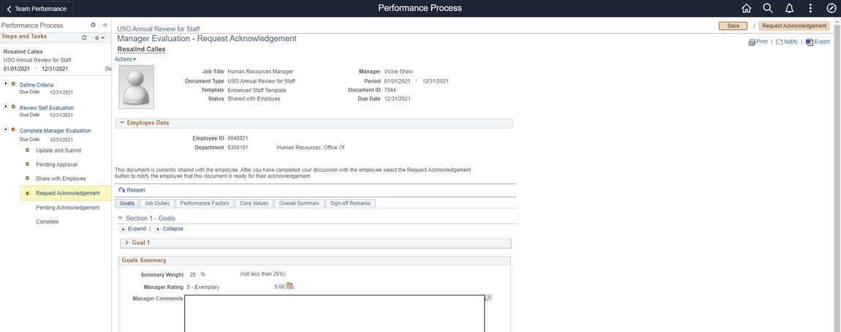
MANAGER: REQUEST EMPLOYEE ACKNOWLEDGEMENT
28
28. Once you have had the evaluation meeting with your employee, navigate back to the evaluation through Manager Self Service. Click Request Acknowledgement. This will give the employee a final opportunity to add comments to the evaluation and electronically acknowledge the document.

Slide 27
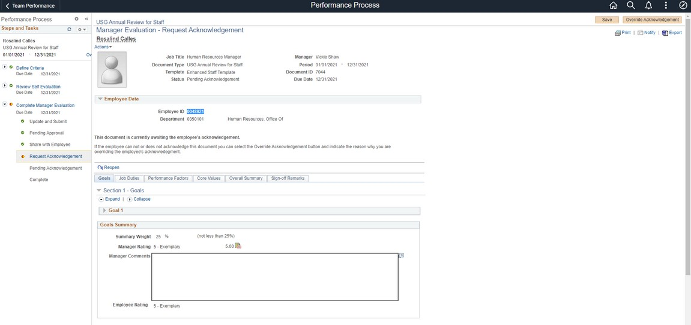
MANAGER: OVERRIDE ACKNOWLEDGEMENT (rarely
used)
Managers can override acknowledgement by the employee if the employee departs the College or is on an extended leave before they acknowledge the evaluation. This option should rarely be used!

Slide 28
Enter goals (Define Criteria)

Slide 29
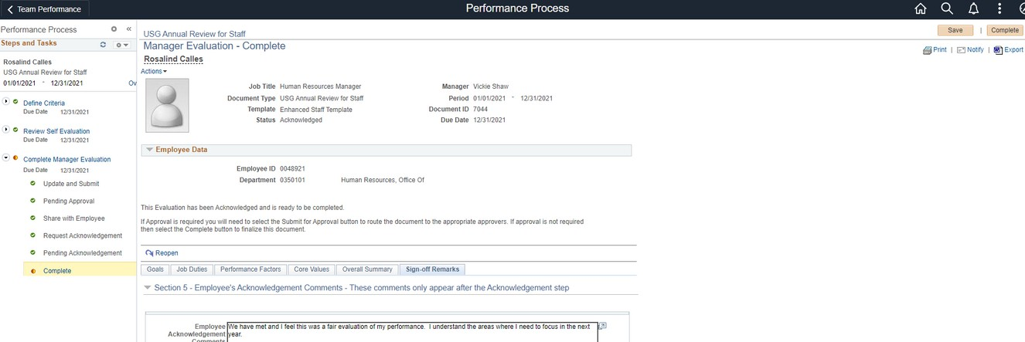
MANAGER: COMPLETE EVALUATION
Navigate to your assigned evaluations in Manager Self Service. You will note the document status as Acknowledged. This means the employee has reviewed and signed the document electronically. Click on the document.
29
29. Review the employee's final comments and click Complete.

Slide 30
MANAGER: COMPLETE EVALUATION
30
30. Confirm completion of the document. This submits the final document to the employee's historical documents and completes the evaluation process.

Slide 31
Enter goals (Define Criteria)

